Slide 1
Attention
Learning Objectives
The Nature and Roles of Attention
Explaining Attention: Information-Processing Theories
Looking to the Brain
Competition: A Single Explanatory Framework for Attention?

Slide 2
In the context of human information processing, attention is the process that, at a given moment, enhances some information and inhibits other information. The enhancement enables us to select some information for further processing, and the inhibition enables us to set some information aside.
Attention
Notes:
Although we have an intuitive understanding of what it means to “pay attention” to an object or event, the study of attention has a long and checkered history in cogni­tive psychology, filled with debate and disagreement. Some have suggested that “everyone knows what attention is;” others have countered that “no one knows what attention is.” (p. 103)

Slide 3
The Nature and Roles of Attention
Failures of Selection
Successes of Selection

Slide 4
Failures of Selection
Failures of Selection in Space
Failures of Selection in Time
Sources of Limitation
Problems in Interpretation
When the Brain Fails

Slide 5
Failures of Selection
When we fail to attend to information, what kind of information do we miss?
One sort of failure occurs when there is a lot of information simultaneously present in front of you, as at a party, and you are simply not capable of noticing all of it at once.
These failures are referred to as failures of selection in space. Failure can also occur with informa­tion that unfolds in time.

Slide 6
Failures of Selection in Space
Failures of selection in space can be of surprising magnitude. Perhaps the most dramatic of these was a demonstration by Simons and Levin (1998) in which an experimenter stopped pedestrians on a college campus to ask for directions.
This failure to detect changes in the physical aspects of a scene has been referred to as change blindness.
This phenomenon often goes to the movies: errors in continuity, such as the switch from the breakfast croissant to the pancake in Pretty Woman, go unnoticed by many in the audience.
Notes:
During each conversation, two people carrying a door walked between the experimenter and the pedestrian. As they did, the experi­menter switched places with a second experimenter who had been concealed behind the door as it was being carried. This second experimenter then continued the conver­sation with the pedestrian. Only half the pedestrians reported noticing the change of speaker—even when they were explicitly asked, “Did you notice that I am not the same person who first approached you to ask for directions?” (p. 105)

Slide 7
Failures of Selection in Space
Failures of selection in space can be of surprising magnitude. Perhaps the most dramatic of these was a demonstration by Simons and Levin (1998) in which an experimenter stopped pedestrians on a college campus to ask for directions.
This failure to detect changes in the physical aspects of a scene has been referred to as change blindness.
This phenomenon often goes to the movies: errors in continuity, such as the switch from the breakfast croissant to the pancake in Pretty Woman, go unnoticed by many in the audience.
Notes:
During each conversation, two people carrying a door walked between the experimenter and the pedestrian. As they did, the experi­menter switched places with a second experimenter who had been concealed behind the door as it was being carried. This second experimenter then continued the conver­sation with the pedestrian. Only half the pedestrians reported noticing the change of speaker—even when they were explicitly asked, “Did you notice that I am not the same person who first approached you to ask for directions?” (p. 105)

Slide 8
Failures of Selection in Space
Change Blindness
  We selectively attend to info in our visual field and ignore the rest.
  Pay attention to “central interest info”.

Slide 9
Failures of Selection in Space
Change Blindness:
  Top down goals change what is “central interest”
  Bottom up information breaks through
    Loud Noises

Slide 10
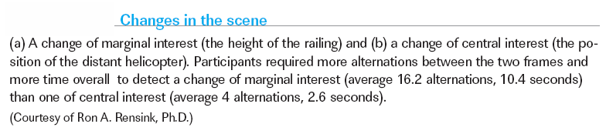
Failures of Selection in Space

Slide 11
Failures of Selection in Space
Concentration on one source of input to the exclusion of any other is known as focused attention; in cases of divided attention, in which more than one source is attended, the information selected is imperfect.

Slide 12
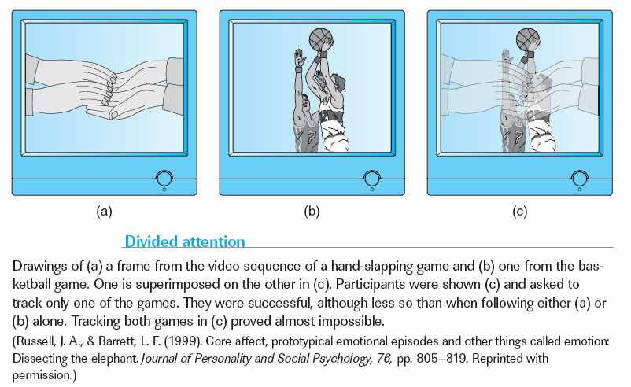
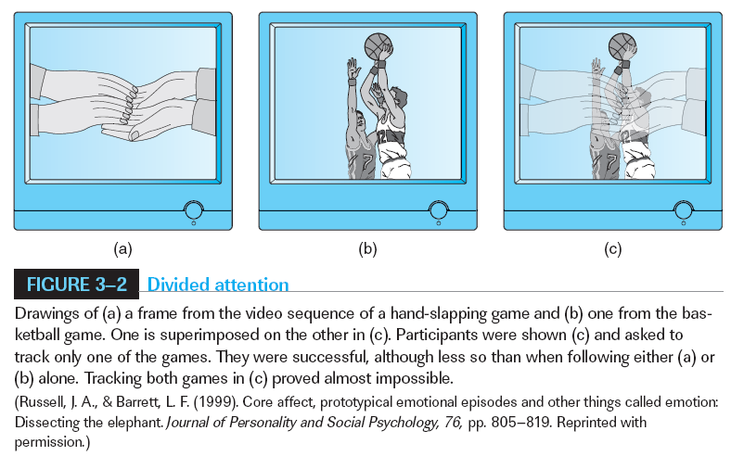
Failures of Selection in Space

